Slide 1
Database Management System (CS403)
VU
Lecture No. 01
Reading Material
“Database Systems Principles, Design and Implementation” written by Catherine Ricardo, Maxwell Macmillan.
Chapter 1.
Overview of Lecture
Introduction to the course
Database definitions
Importance of databases
Introduction to File Processing Systems
Advantages of the Database Approach
Introduction to the course
This course is first (fundamental) course on database management systems. The course discusses different topics of the databases. We will be covering both the theoretical and practical aspects of databases. As a student to have a better understanding of the subject, it is very necessary that you concentrate on the concepts discussed in the course.
Areas to be covered in this Course:
Database design and application development: How do we represent a real-world system in the form of a database? This is one major topic covered in this course. It comprises of different stages, we will discuss all these stages one by one.
Concurrency and robustness: How does a DBMS allow many users to access data concurrently, and how does it protect against failures?
Efficiency and Scalability: How does the database cope with large amounts of data?
1
© Copyright Virtual University of Pakistan

Slide 2
Database Management System (CS403)
VU
o Study of tools to manipulate databases: In order to practically implement, that is, to perform different operations on databases some tools are required. The operations on databases include right from creating them to add, remove and modify data in the database and to access by different ways. The tools that we will be studying are a manipulation language (SQL) and a DBMS (SQL Server).
Database definitions:
Definitions are important, especially in technical subjects because definition describes very comprehensively the purpose and the core idea behind the thing. Databases have been defined differently in literature. We are discussing different definitions here, if we concentrate on these definitions, we find that they support each other and as a result of the understanding of these definitions, we establish a better understanding of use, working and to some extent the components of a database.
Def 1: A shared collection of logically related data, designed to meet the information needs of multiple users in an organization. The term database is often erroneously referred to as a synonym for a “database management system (DBMS)”. They are not equivalent and it will be explained in the next section.
Def 2: A collection of data: part numbers, product codes, customer information, etc. It usually refers to data organized and stored on a computer that can be searched and retrieved by a computer program.
Def 3: A data structure that stores metadata, i.e. data about data. More generally we can say an organized collection of information.
Def 4: A collection of information organized and presented to serve a specific purpose. (A telephone book is a common database.) A computerized database is an updated, organized file of machine readable information that is rapidly searched and retrieved by computer.
Def 5: An organized collection of information in computerized format.
Def 6: A collection of related information about a subject organized in a useful manner that provides a base or foundation for procedures such as retrieving information, drawing conclusions, and making decisions.
Def 7: A Computerized representation of any organizations flow of information and storage of data.
Each of the above given definition is correct, and describe database from slightly variant perspectives. From exam point of view, anyone will do. However, within this course, we will be referring first of the above definitions more frequently, and concepts discussed in the definition like, logically related data, shared collection should be clear. Another
2
© Copyright Virtual University of Pakistan

Slide 3
Database Management System (CS403)
VU
important thing that you should be very clear about is the difference between database and the database management system (DBMS). See, the database is the collection of data about anything, could be anything. Like cricket teams, students, busses, movies, personalities, stars, seas, buildings, furniture, lab equipment, hobbies, hotels, pets, countries, and many more anything about which you want to store data. What we mean by data; simply the facts or figures. Following table shows the things and the data that we may want to store about them:
Thing | Data (Facts or figures)
Cricket Player | Country, name, date of birth, specialty, matches played, runs etc.
Scholars | Name, data of birth, age, country, field, books published etc.
Movies | Name, director, language (Punjabi is default in case of Pakistan) etc.
Food | Name, ingredients, taste, preferred time, origin, etc.
Vehicle | Registration number, make, owner, type, price, etc.
There could be infinite examples, and please note that the data that is listed about different things in the above table is not the only data that can be defined or stored about these things. As has been explained in the definition one above, there could be so many facts about each thing that we are storing data about; what exactly we will store depends on the perspective of the person or organization who wants to store the data. For example, if you consider food, data required to be stored about the food from the perspective of a cook is different from that of a person eating it. Think of a food, like, Karhahi Ghost, the facts about Karhahi ghosht that a cook will like to store may be, quantity of salt, green and red chilies, garlic, water, time required to cook and like that. Where as the customer is interested in chicken or meat, then black or red chilies, then weight, then price and like that. Well, definitely there are some things common but some are different as well. The thing is that the perspective or point of view creates the difference in what we store; however, the main thing is that the database stores the data.
The database management system (DBMS), on the other hand is the software or tool that is used to manage the database and its users. A DBMS consist of different components or subsystem that we will study about later. Each subsystem or component of the DBMS performs different function(s), so a DBMS is collection of different programs but they all work jointly to manage the data stored in the database and its users. In many books and may be in this course sometimes database and database management system are used interchangeably but there is a clear difference and we should be clear about them. Sometimes another term is used, that is, the database system, again, this term has been used differently by different people, however in this course we use the term database system as a combination of database and the database management system. So database is collection of data, DBMS is tool to manage this data, and both jointly are called database system.
3
© Copyright Virtual University of Pakistan

Slide 4
Database Management System (CS403)
VU
Importance of the Databases
Databases are important; why? Traditionally computer applications are divided into commercial and scientific (or engineering) ones. Scientific applications involve more computations, that is, different type of calculations that vary from simple to very complex. Today such applications exist, like in the fields of space, nuclear, medicine that take hours or days of computations on even computers of the modern age. On the other hand, the applications that are termed as commercial or business applications do not involve much computations, rather minor computation but mainly they perform the input/output operations. That is, these applications mainly store the data in the computer storage, then access and present it to the users in different formats (also termed as data processing) for example, banks, shopping, production, utilities billing, customer services and many others. As is clear from the example systems mentioned, the commercial applications exist in the day to day life and are related directly with the lives of common people. In order to manage the commercial applications more efficiently databases are the ultimate choice because efficient management of data is the sole objective of the databases. So such applications are being managed by databases even in a developing country like Pakistan, yet to talk about the developed countries. This way databases are related directly or indirectly almost every person in society.
Databases are not only being used in the commercial applications rather today many of the scientific/engineering application are also using databases less or more. Databases are concerned of effectively latter form of applications which are more Commercialapplicati- ons. The goal of this course is to present an in-depth introduction to databases, with
an emphasis on how to organize information in the database and to maintain it and retrieve it efficiently, that is, how to design a database and use it effectively.
Databases and Traditional File Processing Systems
Traditional file processing system or simple file processing system refers to the first computer-based approach of handling the commercial or business applications. That is why it is also called a replacement of the manual file system. Before the use computers, the data in the offices or business was maintained in the files (well in that perspective some offices may still be considered in the pre-computer age). Obviously, it was laborious, time consuming, inefficient, especially in case of large organizations. Computers, initially designed for the engineering purposes were though of as blessing, since they helped efficient management but file processing environment simply transformed manual file work to computers. So processing became very fast and efficient, but as file processing systems were used, their problems were also realized and some of them were very severe as discussed later.
It is not necessary that we understand the working of the file processing environment for the understanding of the database and its working. However, a comparison between the characteristics of the two definitely helps to understand the advantages of the databases
4
© Copyright Virtual University of Pakistan

Slide 5
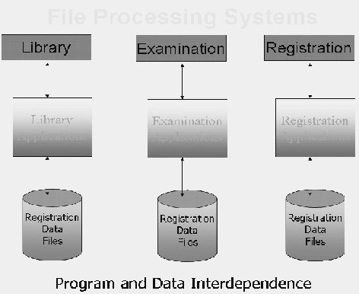
Database Management System (CS403)
VU
and their working approach. That is why the characteristics of the traditional file processing system environment have been discussed briefly here.
Fig. 1: A typical file processing environment
The diagram presents a typical traditional file processing environment. The main point being highlighted is the program and data interdependence, that is, program and data depend on each other, well they depend too much on each other. As a result any change in one affects the other as well. This is something that makes a change very painful or problematic for the designers or developers of the system. What do we mean by change and why do we need to change the system at all. These things are explained in the following.
The systems (even the file processing systems) are created after a very detailed analysis of the requirements of the organizations. But it is not possible to develop a system that does not need a change afterwards. There could be many reasons, mainly being that the users get the real taste of the system when it is established. That is, users tell the analysts or designers their requirements, the designers design and later develop the system based on those requirements, but when system is developed and presented to the users, it is only then they realize the outcome of the effort. Now it could be slightly and (unfortunately) sometimes very different from what they expected or wanted it to be. So the users ask changes, minor or major. Another reason for the change is the change in the requirements. For example, previously the billing was performed in an organization on the monthly
5
© Copyright Virtual University of Pakistan

Slide 6
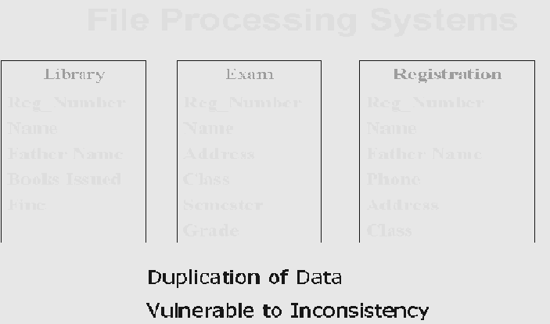
Database Management System (CS403)
VU
basis, now company has decided to bill the customers after every ten days. Since the bills are being generated from the computer (using file processing system), this change has to be incorporated in the system. Yet another example is that, initially bills did not contain the address of the customer, now the company wants the address to be placed on the bill, so here is change. There could be many more examples, and it is so common that we can say that almost all systems need changes, so system development is always an on-going process.
So we need changes in the system, but due to program-data interdependence these changes in the systems were very hard to make. A change in one will affect the other whether related or not. For example, suppose data about the customer bills is stored in the file, and different programs use this file for different purposes, like adding data into the bills file, to compute the bill and to print the bill. Now the company asks to add the customers’ address in the bills, for this we have to change the structure of the bill file and also the program that prints the bill. Well, this was necessary, but the painful thing is that the other programs that are using these bills files but are not concerned with the printing of the bills or the change in the bill will also have to be changed, well; this is needless and causes extra, unnecessary effort.
Another major drawback in the traditional file system environment is the non-sharing of data. It means if different systems of an organization are using some common data then rather than storing it once and sharing it, each system stores data in separate files. This creates the problem of redundancy or wastage of storage and on the other hand the problem on inconsistency. The change in the data in one system sometimes is not reflected in the same data stored in other system. So different systems in organization; store different facts about same thing. This is inconsistency as is shown in figure below.
Fig. 2: Some more problems in File System Environment
6
© Copyright Virtual University of Pakistan

Slide 7
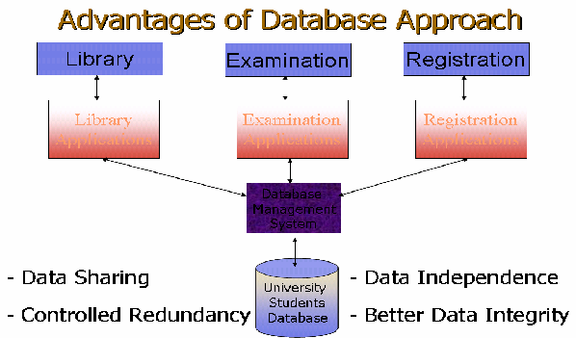
Database Management System (CS403)
VU
Previous section highlighted the file processing system environment and major problems found there. The following section presents the benefits of the database systems.
Advantages of Databases
It will be helpful to reiterate our database definition here, that is, database is a shared collection of logically related data, designed to meet the information needs of multiple users in an organization. A typical database system environment is shown in the figure 3 below:
Fig. 3: A typical Database System environment
The figure shows different subsystem or applications in an educational institution, like library system, examination system, and registration system. There are separate, different application programs for every application or subsystem. However, the data for all applications is stored at the same place in the database and all application programs, relevant data and users are being managed by the DBMS. This is a typical database system environment and it introduces the following advantages:
o Data Sharing
The data for different applications or subsystems is placed at the same place. This introduces the major benefit of data sharing. That is, data that is common among different applications need not to be stored repeatedly, as was the case in the file processing environment. For example, all three systems of an educational institution shown in figure 3 need to store the data about students. The example data can be seen
7
© Copyright Virtual University of Pakistan

Slide 8
Database Management System (CS403)
VU
from figure 2. Now the data like registration number, name, address, father name that is common among different applications is being stored repeatedly in the file processing system environment, where as it is being stored just once in database system environment and is being shared by all applications. The interesting thing is that the individual applications do not know that the data is being shared and they do not need to. Each application gets the impression as if the data is being for stored for it. This brings the advantage of saving the storage along with others discussed later.
Data Independence
Data and programs are independent of each other, so change is once has no or minimum effect on other. Data and its structure is stored in the database where as application programs manipulating this data are stored separately, the change in one does not unnecessarily effect other.
Controlled Redundancy
Means that we do not need to duplicate data unnecessarily; we do duplicate data in the databases, however, this duplication is deliberate and controlled.
Better Data Integrity
Very important feature; means the validity of the data being entered in the database. Since the data is being placed at a central place and being managed by the DBMS, so it provides a very conducive to check or ensure that the data being entered into the database is actually valid. Integrity of data is very important, since all the processing and the information produced in return are based on the data. Now if the data entered is not valid, how can we be sure that the processing in the database is correct and the results or the information produced is valid? The businesses make decisions on the basis of information produced from the database and the wrong information leads to wrong decisions, and business collapse. In the database system environment, DBMS provides many features to ensure the data integrity, hence provides more reliable data processing environment.
Dear students, that is all for this lecture. Today we got the introduction of the course, importance of the databases. Then we saw different definitions of database and studied what is data processing then studied different features of the traditional file processing environment and database (DB) system environment. At the end of lecture we were discussing the advantages of the DB approach. There some others to be studied in the next lecture. Suggestions are welcome.
Exercises
Think about the data that you may want to store about different things around you
List the changes that may arise during the working of any system, lets say Railway Reservation System
8
© Copyright Virtual University of Pakistan

Slide 9
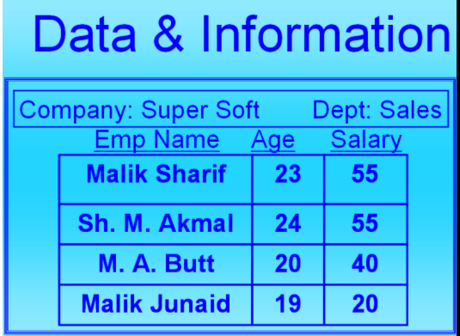
Database Management System (CS403)
VU
Lecture No. 02
Reading Material
“Database Systems Principles, Design and Implementation” written by Catherine Ricardo, Maxwell Macmillan.
Overview of Lecture
Some Additional Advantages of Database Systems
Costs involved in Database systems
Levels of data
Database users
Difference between Data and Information
Data is the collection of raw facts collected from any specific environment for a specific purpose. Data in itself does not show anything about its environment, so to get desired types of results from the data we transform it into information by applying certain processing on it. Once we have processed data using different methods data is converted into meaningful form and that form of the Data is called information
Example:
Example:
Fig. 1: Data and Information
9
© Copyright Virtual University of Pakistan

Slide 10
Database Management System (CS403)
VU
If we consider the data in the above figure without the titles or the labels associated with the data (EmpName, age, salary) then it is not much useful. However, after attaching these labels it brings some meanings to us, this meaningfulness is further increased when we associate some other labels, like the company name and the department name etc. So this is a very simple example of processing that we can do on the data to make it information.
Once we have clear idea of what data and information is we proceed with another term knows as “schema” Schema is a repository or structure to express the format and other different information about data and database, as we can see from the database definition “Database is a self describing collection of interrelated records.” The word self describing means that the data storage and retrieval mechanism and its format is described in the database, Actual place where these definitions and descriptions are performed is database schema.
Database Application:
Database Application is a program or group of programs which is used for performing certain operations on the data stored in the database. These operations may contain insertion of data into a database or extracting some data from the database based on a certain condition, updating data in the database, producing the data as output on any device such as Screen, disk or printer.
Database Management Systems:
Database management system is software of collection of small programs to perform certain operation on data and manage the data.
Two basic operations performed by the DBMS are:
Management of Data in the Database
Management of Users associated with the database.
Management of the data means to specify that how data will be stored, structured and accessed in the database.
Management of database users means to manage the users in such a way that they can perform any desired operations on the database. DBMS also ensures that a user can not perform any operation for which he is not allowed. And also an authorized user is not allowed to perform any action which is restricted to that user.
In General DBMS is a collection of Programs performing all necessary actions associated to a database.
10
© Copyright Virtual University of Pakistan

Slide 11
Database Management System (CS403)
VU
Further Advantages of Database Systems:
Database systems are very much beneficent to enterprises and businesses, some of the
advantages are listed below:
Data consistency
Better data security
Faster development of new applications
Economy of scale
Better concurrency control
Better backup and recovery procedures
Data Consistency:
Data consistency means that the changes made to different occurrence of data should be
controlled and managed in such a way that all the occurrences have same value for any specific data item. Data inconsistency leads to a number of problems, including loss of information and incorrect results. In database approach it is controlled because data is shared and consistency is controlled and maintained.
Better Data Security:
All application programs access data through DBMS, So DBMS can very efficiently
check that which user is performing which action and accessing which part of data , So A DBMS is the most effectively control and maintain security of Data stored in a database.
Faster Application Development:
The database environment allows us faster application development because of its many
reasons. As we know that database is designed with the factor of future development in mind
So whenever we have to build a new application to meet the growing needs of the computerized environment, it may be easy due to the following reason:
The data needed for the new application already resides in the database.
11
© Copyright Virtual University of Pakistan

Slide 12
Database Management System (CS403)
VU
The data might not already reside in the database but it could be derived from the data present in the database
Thus we can say that, to develop a new application for an existing database system less effort is required in terms of the system and database design.
o Economy of Scale:
Databases and database systems are designed to share data stored in one location for
many different purposes, So it needs not be stored as many number of times in different
forms as it is used, for example the data used by Admission Department of any education institution can be used to maintain the attendance record of the students as well as the examination records of the students. So it saves us lots of efforts and finances providing economy of scale.
o Better Concurrency Control:
Concurrency means the access of database form as number of points simultaneously.
Concurrency control means to access the database in such a way that all the data accesses
are completed correctly and transparently. One example of controlled concurrency is the use of ATM Machine for withdrawal of money (cash). All ATM machines of a bank are interconnected to a central database system worldwide, so that a user can access its account from anywhere in the world and can get cash from any ATM terminal. As there are thousands of ATM terminal across the world for a specific bank so as a result thousands of user process and access the bank’s database. All this process is managed concurrently using the database systems and is done in such an efficient manner that no two user face any delay in the processing of their requests.
o Better Backup and Recovery Facility:
Data is a very important resource and is very much valuable for any organization, loss of
such a valuable resource can result in a huge strategic disasters. As Data is stored on today’s’ storage devices like hard disks etc., It is necessary to take periodic backups of data so that in case a storage device looses the data due to any damage we should be able
12
© Copyright Virtual University of Pakistan

Slide 13
Database Management System (CS403)
VU
to restore the data a nearest point, Database systems offer excellent facilities for taking backup of data and good mechanism of restoring those backups to get back the backed-up data.
It some time happens that a database which was in use and very important transactions
were made after the last backup was made, all of a sudden due to any disastrous situation the database crashes (improper shutdown, invalid disk access, etc.) Now in such a situation the database management system should be able to recover the database to a consistent state so that the transactions made after the last backup are not lost.
Cost Involved:
Enjoying all these benefits of the database systems do have some additional costs on any
organization which is going to adopt a database environment. These charges may also be known as the disadvantages of the database system. Different types of costs (Financial and Personnel) which an organization faces in adopting a database system are listed below:
High Cost:
Database Systems have a number of inherent charges which are to be born by any
organization that is going to adopt it. High Cost is one of these inherent charges, it includes the need for specialized software which is used to run database systems, Additional and specialized hardware and technically qualified staff are the requirements for adopting to the database system, all these requirements need an organization to invest handsome amount of money to have all the requirements of the database systems.
Conversion Cost:
Once an organization has decided to adopt database system for its operations, it is not
only the finance and technical man-power which is required for switching on to database system, it further has some conversion charges needed for adopting the database system, this is also a very important stage for making decision about the way the system will be converted to database system.
13
© Copyright Virtual University of Pakistan

Slide 14
Database Management System (CS403)
VU
o Difficult Recovery Procedures:
Although the database systems and database management systems provide very efficient
ways of data recovery in case of any disaster, still the process of recovering a crashed database is very much technical and needs good professional skills to perform a perfect recovery of the database.
Importance of Data
o Data as a Resource:
A resource is anything which is valuable for an organization. There can be a number of
resources in any organization, for example, Buildings, Furniture, Vehicle, Technical Staff, Managers, supporting staff and Machinery etc. As all these are resources for
organizations and are consumed very much carefully to get full benefit out of them. Data in the same way is a very important resource and needs to considered equally important as other resource are considered.
Why we call data as a resource?
Data is truly considered a resource because for an organization to make proper decisions at proper time it is only the data which can provide correct information and in-turn cause good utilization of other organizational resources. Organizations can not make good and effective decisions if the required data is not available in time or in the correct and desired format, such bad and miscalculated decisions ultimately lead to the failure of organizations or business.
Levels of Data
o Real World Data
The real world level of data means that level of data at which entities or objects exist in
reality, it means that any object existing in reality have a name and other identifiable attributes through which we can identify that specific object or entity.
Example:
Any Student
14
© Copyright Virtual University of Pakistan

Slide 15
Database Management System (CS403)
VU
o Meta Data:
For storage of the data related to any entity or object existing at real world level we
define the way the data will be stored in the database. This is called Meta data. Meta data is also known as schema for the real world data. It tells that what type of data will be
stored in the database, what will be size of a certain attribute of the real world data, how many and what attributes will be used to store the data about the entity in the database.
Example: Name , Character Type, 25 character size field, Age, Date type, 8 bytes size
Class, Alpha Numeric, 8 byte size field
o Existence of Data:
Existence of the data level shows the actual data regarding the entities as real world level
according to the rules define at the Meta Data level. Example:
According to the definition given in the Meta data level the Actual data or Data occurance for the entity at real world level is shown below:
Name Age Class
Ali Amir
MCS-I MCS-II
20/8/1979
22/3/1978
etc…
15
© Copyright Virtual University of Pakistan

Slide 16
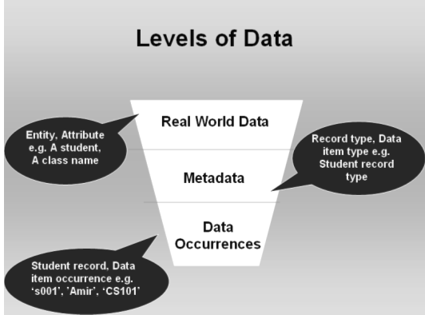
Database Management System (CS403)
VU
Fig. 2: Levels of Data
Users of Database Systems:
Application Programmers
End Users
Naïve
Sophisticated
Application programmers:
This category of database users contains those people who create different types of
database application programs that we have seen earlier. Application programmers design the application according to the needs of the other users of the database in a certain environment. Application programmers are skilled people who have clear idea of the structure of the database and know clearly about the needs of the organizations.
End Users:
16
© Copyright Virtual University of Pakistan

Slide 17
Database Management System (CS403)
VU
Second category of the Database users are the end users, this group of users contains the people who use the database application programs developed by the Application
programmers. This category further contains two types of users:
Naïve Users
Sophisticated Users
Naïve Users
This category of users is that category who simply use the application database programs created by the programmers. This group has no interaction with other parts of there database and only use the programs meant for them. They have not to worry about the further working of the database.
Sophisticated Users:
This type of users has some additional rights over the Naïve users, which means that they can access the data stored in the database any of their desired way. They can access data using the application programs as well as other ways of accessing data. Although this type of users has more rights to access data, but these users have to take more responsibility and they need to be aware of the database structure. Moreover such users should be skilled enough to be able to get data from database with making and damage or loss to the data in database.
o Database Administrators (DBA):
This class of database users is the most technical class of db users. They need to have the
knowledge of how to design and manage the database use as well as to manage the data in the database. DBA is a very responsible position in an organization. He is responsible for proper working of the database and DBMS, has the responsibility of making proper database backups and make necessary actions for recovering the database in case of a database crash. To fulfill the requirements of a DBA position a DBA needs vast experience and very elegant technical skills.
25
© Copyright Virtual University of Pakistan

Slide 18
Database Management System (CS403)
VU
Duties of the DBA
A Database administrator has some very precisely defined duties which need be
performed by the DBA very religiously. A short account of these jobs is listed below:
Schema definition
Granting data access
Routine Maintenance
Backups
Monitoring disk space
Monitoring jobs running
o Schema Design
DBA in some organization is responsible for designing the database schema, which
means that DBA is the person who create all the meta data information for the organization on which the database is based. However in some very large scale organizations this job is performed by the database designer, which is hired for the
purpose of database design and once the database system is installed and working, it is handed over to the DBA for further operation.
Granting Access to Users:
DBA is also responsible for grant of access rights to the database users. Along with
granting and revoking (taking back) the rights the DBA continuously monitors and ensure the legal use of these rights.
Monitoring Disk Space :
When a new database is created it takes a limited space but as a result of daily activity the
database acquires more data and grows in size very rapidly. The DBA has to monitor the disk space usage and statistics to ensure that no data over flow occurs at any stage.
Monitoring Running Jobs:
To ensure the secure and proper functioning of the database system a DBA continuously
monitors some associated activities also and ensure that all users are using their
18
© Copyright Virtual University of Pakistan

Slide 19
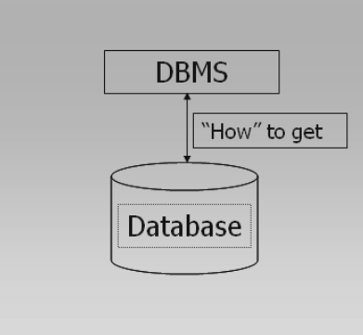
Database Management System (CS403)
VU
authorities legally and different devices attached to the database system are functioning properly.
Typical Components of a Database Environment:
Different typical components of a database environment are shown in the figures below; they describe graphically the role of different types of users.
Fig. 3: DBMS and Database
Database is used to store data and DBMS uses mechanisms to get data from the database
19
© Copyright Virtual University of Pakistan

Slide 20
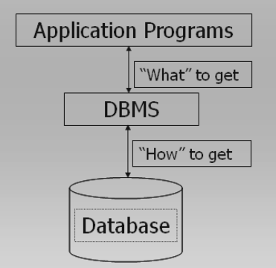
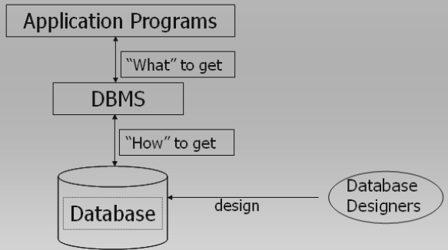
Database Management System (CS403)
VU
Fig. 4: Application Programs
Application programs talk to DBMS and ask for the data required
Fig. 5: Database Designers
Database designers design (for large organizations) the database and install the DBMS for use by the users of the database in any specific organization.
20
© Copyright Virtual University of Pakistan

Slide 21
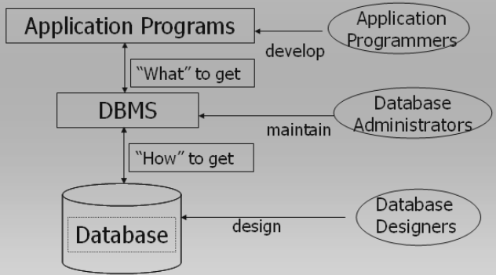
Database Management System (CS403)
VU
Fig. 6: Database Administrator
Once Database has been installed and is functioning properly in a production environment of an organization the Database Administrator takes over the charge and performs specific DBA related activities including:
Database maintenance
Database Backup
Grant of rights to database users
Monitoring of Running Jobs
Managing Print jobs
Ensuring quality of Service to all users
21
© Copyright Virtual University of Pakistan

Slide 22
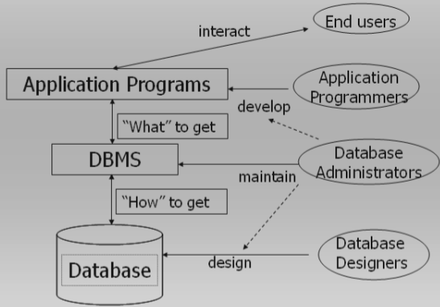
Database Management System (CS403)
VU
Fig. 7: Database Administration’s interaction with other users
Database administrator can interact with the database designer during database design phase so that he has a clear idea of the database structure for easy reference in future.
This helps DBA perform different tasks related to the database structure.
DBA also interacts with the application programmers during the application development process and provides his services for better design of applications.
End users also interact with the system using application programs and other tools as specified in the description above.
This concludes lecture number 2, in case of any queries, please feel free to contact.
22
© Copyright Virtual University of Pakistan

Slide 23
Database Management System (CS403)
VU
Lecture No. 03
Reading Material
“Database Systems Principles, Design and Implementation” written by Catherine Ricardo, Maxwell Macmillan.
Section: 4.1.2
4.1.1,
Overview of Lecture
Database Architecture
External View of the database
Conceptual view of the database
Database Architecture:
Standardization of database systems is a very beneficent in terms of future
growth, because once a system is defined to follow a specific standard, or is built on a specific standard, it provides us the ease of use in a number of aspects.
First if any organization is going to create a new system of the same usage shall create the system according to the standards and it will be easier to develop,
because the standards which are already define will be used for developing the system.
Secondly if any organization wants to create and application software that will provide additional support to the system, it will be an easier task for them to
develop such system and integrate them into existing database applications. Users which will be using the system will be comfortable with the system
because a system built on predefined standards is easy to understand and use, rather than understanding learning and using an altogether new system which is
designed and built without following any standards.
23
© Copyright Virtual University of Pakistan

Slide 24
Database Management System (CS403)
VU
Expansion to systems which are not built on standards is very hard and needs lots of efforts.
Technical staff working on a system built on standard has no problem to learn the use and architecture of the system and whenever there is a need in change of staff new staff members can be hired and put to work without any prior training for the use of system.
Database standard proposed by ANSI SPARK in 1975 is being used worldwide and is the only most popular agreed upon standard for database systems.
The Three Level Schema architecture provides us a number of benefits. For accessing data at different levels we have a number of users because not all users have to access data in database at all the database levels. The 3 levels architecture allows us to separate the physical representation of data from the users’ views of data.
In the database, same data is stored in a specific feasible format and is available
to different users in different formats as desired by different users. For example, consider we have stored the DOB (Date of Birth) in the database in a particular format, like in the form of dd-mm-yyyy (for example, 28-03-1987). However, the users from different departments may require to view the date of birth in different forms; the examination department may ask it to be displayed as month-day-yyyy (like march-28-1987) the Registrar’s office may ask to display date of birth as mm/dd/yyyy, still the Library may need the in the form of dd/mm/yy. The Three Level Schema allows us to access the data in different formats at the external level, which is stored in a specific format at the internal level.
The Three levels architecture is useful for hiding the details of internal systems; it
in-fact hides the details of underlying system views from the users at other levels and restricts the access of data and the system from any unauthorized intervention. It is the mechanism which allows us to store the data in the system in such a way that it can be provided to all users in their desired formats and with unveiling other details and information stored in the database. Moreover if there is a change to be done to the data stored in the database subject to the
24
© Copyright Virtual University of Pakistan

Slide 25
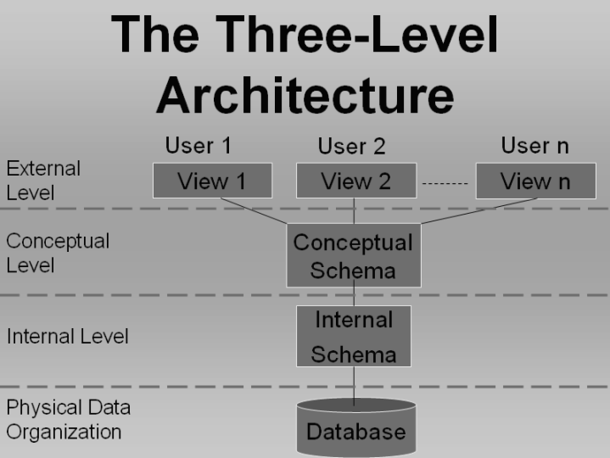
Database Management System (CS403)
VU
requirements of a specific user it needs not be changed for that user specifically, we can create a change to the specific external view of that user and the internal details remain unchanged. Also if we want to change the underlying storage mechanism of the data stored on the disk we can do it without affecting the internal and conceptual view at the lowest level in the three levels architecture is the internal view or internal level which is shown below in the diagram and is illustrated in the coming lines.
Fig. 1: Three level architecture of database
The Architecture:
The schemas as it has been defined already; is the repository used for storing
definitions of the structures used in database, it can be anything from any entity to the whole organization. For this purpose the architecture defines different schemas stored at different levels for isolating the details one level from the other.
25
© Copyright Virtual University of Pakistan

Slide 26
Database Management System (CS403)
VU
Different levels existing at different levels of the database architecture are expressed below with emphasis on the details of all the levels individually.
Core of the database architecture is the internal level of schema which is discussed a bit before getting into the details of each level individually. The internal level implements all the inner details and defines the intentions of the database. Internal schema or view defines the structures of the data and other data related activities in the database. For example it defines that for a student what data will be stored in terms of attributes of the student and it also defines how different values for these attributes will be stored, also it tells that who is allowed to make changes to the database and what changes he can make, etc.
These details give us the internal schema and are called the intention of the database. Intention for a database is almost permanent, because while designing the database it is ensured that no information is left behind which is important enough to be stored in the database and what information is important to be stored in the database from the future point of view.
Once the intention of the database has been defined then it is undesirable to
change the intention for any reason. Because any small change in the intention of the database may need a lot of changes to be made to the data stored in the database. Extension of the database is performed on the bases of a complete intention, i-e once a database has been defined it is populated with the data of the organization for which the database is created. This population of the database is also called as the extension of the database. Extension is always done according to the rules defined in the internal schema design or the intention of the database.
Effects of changes made to different levels of the database architecture: We can make changes to the different levels of the database but these changes need very serious consideration before they are made, Changes at different levels of database architecture need different levels of users attention for example a change to the data made for the extension of data will effect only a single record whereas when we make a change to the internal level of the
26
© Copyright Virtual University of Pakistan

Slide 27
Database Management System (CS403)
VU
database the change effects all the stored records, similarly an invalid change in the extension of the database is not that fatal as a change in the intention of the
database because a change in the extension of the database is not very hard to undo; incase of a mishap whereas a change of the same magnitude to the intention of the database might cause a large number of database errors (inconsistencies and data loss).
External View (Level, Schema or Model):
This level is explicitly an end user level and presents data as desired by the
users of the database. As it is known that the database users are classified on two grounds
Section of the organization
Nature of Job of the users
The external level of the database caters to the needs of all the database users
starting from a user who can view the data only which is of his concern up-to the users who can see all the data in the database and make all type of actions on that data.
External level of the database might contain a large number of user views, each
user view providing the desired features and fulfilling requirements for the user or user group for which it is intended. The restriction or liberty a user or user groups get in his rights is the external view of that user groups and is decided very carefully.
External views are also helpful when we want to display the data which is not place in the database or not stored at all. Example of the first case can be a customer Phone number stored in the database. But when contacting the person it might appear that the area code for that specific user is not stored in the database, in that case we can simply pick up the area or city id of the customer and find the area code for that city from the corresponding Area Codes table.
Another situation may arise when we want to get a student enrolled in an institution and want to make sure that the student qualifies for the minimum required age limit, we will look the database, for the students age but if we have
27
© Copyright Virtual University of Pakistan

Slide 28
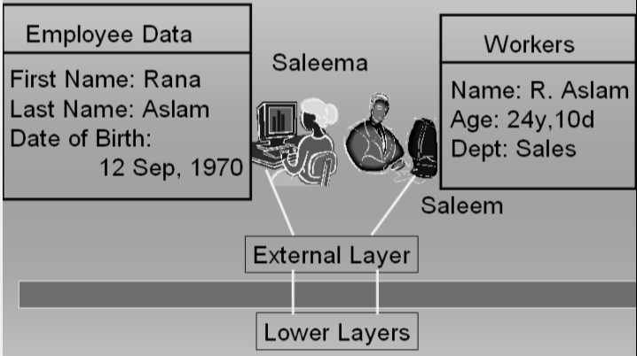
Database Management System (CS403)
VU
stored only the date of birth of the student then the age of the student needs to be calculated at that very instance; this can be done very easily in the specific
user view and age of the student can be calculated, even the user-view itself can tell use whether the student qualifies for the admission or not.
As the user view is the only entity or the interface through which a user will operate the database or use it so it must be designed in such a way that it is easy to use and easy to manage and self descriptive, also it is easy to navigate through. Also it should not allow the user to get or retrieve data which is not allowed to the user, so the user view should both be a facilitator and also a barrier for proper utilization of the database system.
As the system grows it is possible that a user view may change in structure, design and the access it provides to the users. SO External views are designed and create in way that they can be modified at a later stage without making any changes in the logical or internal views.
In the diagram below we can see two different users working as end users having their own external view; we can see that the same data record is displayed in two entirely different ways.
Fig. 2: Mapping between External layer and lower layers
28
© Copyright Virtual University of Pakistan

Slide 29
Database Management System (CS403)
VU
Conceptual or Logical View:
This is the level of database architecture which contains the definition of all the
data to be stored in the database and also contains rules and information about that structure and type of that data.
The conceptual view is the complete description of the data stored in the database. It stores the complete data of the organization that is why it is also known as the community view of the database. The conceptual view shows all the entities existing in the organization, attribute or characteristics associated with those entities and the relationships which exist among the entities of the organization.
We can take the example of the customers of a company. Now the conceptual schema will have all the details of the products of the company, retailing stores of the company, products present in the stock, products which are ready to be delivered, salespersons of the company, manager of the company and literally every other thing which is associated with the business of the company in any way.
Now after having all the information we know that the customers buy products from the outlets of the company, thus in such a case a specific customer has a relationship with that specific outlet of the company, or the customer may be represented as having association with the sales person which in-turn has association with the outlet., there may be a number of customers at a certain outlet and also to mange these salespersons there will be one or more managers. We can see from the above given scenario that all the entities are logically related to each other in way or the other. The conceptual schema actually manages all such relationship and maps these relationships among the member entities. Conceptual schema along-with having all the information which is to be stored in the database stores the definition of the data to be stored. The definition may contain types of data, and constraints on data values etc.
29
© Copyright Virtual University of Pakistan

Slide 30
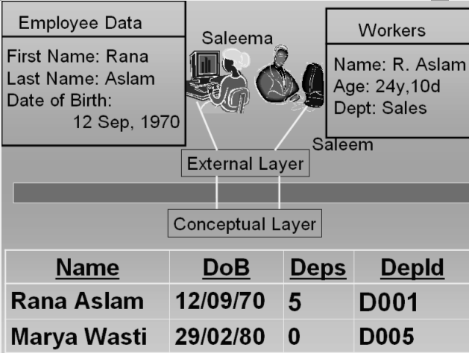
Database Management System (CS403)
VU
Conceptual schema is also responsible for holding the authorization and authentication information, means that only those people can make use of the database whom we have allowed to make these changes, so therefore it is the task of the DBMS to ensure be checking the conceptual schema that he is authorized to check the data or make any changes to the data.
Conceptual schema as it describes the intention of the database; it is not
changed often, because to make a change to the conceptual schema of the database requires lots of consideration and may involve changes to the other views/levels of the database also.
As in the previous example we saw two database users accessing the database
and we saw that both of them are having totally different user views. Here when we see in the logical view of the data we can see that the data stored in the database is stored only once and two users get different data from the same copy of data at the underlying conceptual level.
Fig. 3: External and conceptual layers
By summarizing it all we can say that the external view is the view of database system in which user get the data as they need and these database users need
30
© Copyright Virtual University of Pakistan

Slide 31
Database Management System (CS403)
VU
not to worry about the underlying details of the data, all these users have to do is to provide correct requirement information to the DBA or the database designer whoever is designing the database for the system, so that the DBA or the database designer can create the database in such a way that they can fulfill the users requirements using the conceptual schema of the database.
Conceptual view/schema is that view of the database which holds all the
information of the database system and provides basis for creating any type of the required user views and can accommodate any user fulfilling his/her requirements.
Exercise:
The data examples that you defined in the exercises of lecture 1, think of the different forms of data at the external and conceptual level. Also try to define mapping between them.
31
© Copyright Virtual University of Pakistan

Slide 32
Database Management System (CS403)
VU
Lecture No. 04
Reading Material
“Database Systems Principles, Design and Implementation” written by Catherine Ricardo, Maxwell Macmillan. | 4.1 .3, 4.1.4
Hoffer | Chapter 2
Overview of Lecture
Internal Schema of the Database Architecture
Data Independence
Different aspects of the DBMS
Internal or Physical View / Schema
This is the level of the database which is responsible for the storage of data on the storage media and places the data in such a format that i t is only readable by the DBMS. Although the internal view and the physical view are so close that they are generally referred to a single layer of the DBMS but there lays thin line which actually separated the internal view from the physical view. As we know that data when stored onto a magnetic media is stored in binary format, because this is the only data format which can be represented electronically, No matter what is the actual format of data, either text, images, audio or video. This binary storage mechanism is always implemented by the Operating System of the Computer. DBMS to some extent decides the way data is to be stored on the disk. This decision of the DBMS is based on the requirements specified by the DBA when implementing the database. Moreover the DBMS i tself adds information to the data which is to be stored. For example a DBMS has selected a specific File organization for the
32
© Copyright Virtual University of Pakistan

Slide 33
Database Management System (CS403)
VU
storage of data on disk, to implement that specif ic fi le system the DBMS needs to create speci fic indexes. Now whenever the DBMS will attempt to retrieve the data back form the f ile organization system it will use the same indexes information for data retrieval. This index information is one example of additional information which DBMS places in the data when storing it on the disk. At the same level storage space utilization if performed so that the data can be stored by consuming minimum space, for this purpose the data compression can be performed, this space optimization is achieved in such a way that the performance of retrieval and storage process is not compromised. Another important consideration for the storage of data at the internal level is that the data should be stored in such a way that i t is secure and does not involve any security risks. For this purpose different data encryption algorithms may be used. Lines below detail further tidbits of the internal level.
The difference between the internal level and the external level demarcates a boundary between these two layers, now what is that difference, i t in fact is based on the access or responsibility of the DBMS for the representation of data. At the internal Level the records are presented in the format that are in match with schema definition of the records, whereas at the physical level the data is not strictly in record format, rather it is in character format., means the rules identified by the schema of the record are not enforced at this level. Once the data has been transported to the physical level i t is then managed by the operating system. Operating system at that level uses i ts own data storage utilities to place the data on disk.
Inter Schema Mapping:
The mechanism through which the records or data at one level is related to the changed format of the same data at another level is
known as mapping. When we associate one form of data at the external level with the same data in another form is know as the
external/conceptual mapping of the data. ( We have seen examples of external/conceptual mapping in the previous lecture) In the
same way when data at the conceptual level is correlated with the same data at the internal level, this is called the conceptual/Internal
mapping.
Now the question arises that how this mapping is performed. Means how is it possible to have data at one level in date format and at a higher level the same data show us the age. This hidden mechanism, conversion system or the formula which converts the date of birth of an employee into age is performed by the mapping function and
33
© Copyright Virtual University of Pakistan

Slide 34
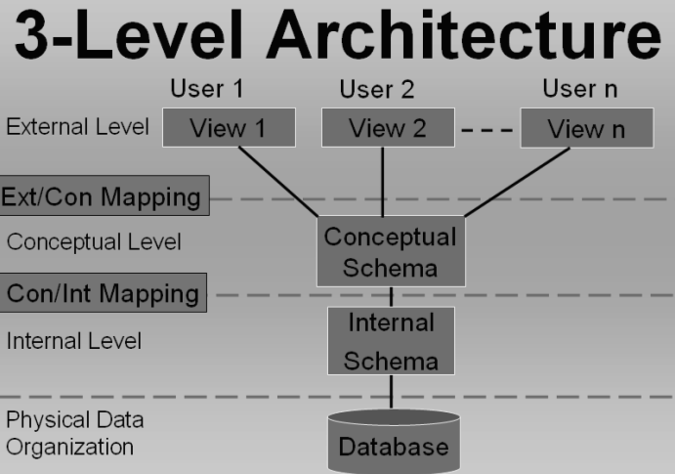
Database Management System (CS403)
VU
it is defined in the specific ext/ con mapping, for example, when the data at the conceptual level is presented as the age of the employee is done by the external schema of that specific user. Now in this scenario the ext/ con mapping is performing the mapping with the internal view and is retrieving the data in desire format of the user.
In the same way the mapping between an internal view and conceptual view is performed.
The figure below gives a clear picture of this mapping process and informs where the mapping between different levels of the database is performed.
Fig:1: Mapping between External/Conceptual and Conceptual/Internal levels
In Figure-1 we can see clearly where the mapping or connectivity is performed between different levels of the database management system. Figure-1 is showing another very important concept that the internal layer and the physical layers lie separately the Physical layer is explicitly used for data storage on disk and is the responsibility of the Operating system. DBMS has almost no concern with the details of the physical level other than that i t passes on the data along- with necessary instructions required to the store that data to the operating system.
Figure-2 on the next page shows how data appears on different levels of the database architecture and also at that of physical level. We can clearly see that the data store on the physical level is in
binary format and is separate from the location and format. Separation of the internal level is of great use in terms of data retrieval.
internal view of data in physical level from the efficiency of storage and
34
© Copyright Virtual University of Pakistan

Slide 35
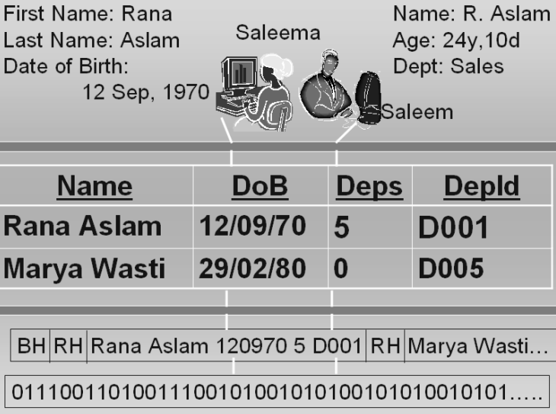
Database Management System (CS403)
VU
Fig: 2. Representation of data at different levels of data base Architecture and at the physical level at bottom
At the internal level we can see that data is prefixed with Block Header and Record header RH, the Record header is prefixed to every record and the block header is prefixed to a group of records; because the block size is generally larger than the record size, as a result when an application is producing data it is not stored record wise on the disk rather block wise which reduces the number of disk operations and in- turn improves the efficiency of writing process.
Data Independence:
Data Independence is a major feature of the database system and one of the most important advantages of the Three Level Database
Architecture. As i t has processing system makes dependent on each other,
been discussed already the application programs I-e if we want to make a
that the fi le and the data change in the
data we will have to make or reflect the corresponding change in the associated applications also.
The Three Level Architecture facilitates us in such a way that data independence is automatically introduced to the system. In other words we can say the data independence is major most objective of the Three Level Architecture. If we do not have data independence then whenever there will be a change made to the internal or
35
© Copyright Virtual University of Pakistan

Slide 36
Database Management System (CS403)
VU
physical level or the data accessing strategy the
applications
running at the external level will demand to be changed because they will not be able to properly access the changed internal or physical levels any more. As a result these applications will stop working and ultimately the whole system may fail to operate.
The Data independence achieved as a result of the three level architecture proves to be very useful because once we have the data , database and data applications independent of each other we can easily make changes to any of the components of the system, without effecting the functionality and operation of other interrelated components.
Data and program independence is on advantage of the 3 -L architecture the other major advantage is that ant change in the lower level of the 3-L architecture does not effect the structure or
the functionality on upper levels. I- e we
get external/conceptual by the three levels
and conceptual/internal independence
Architecture.
Data independence can be classified into level at which the independence is obtained.
two type based on the
Logical Data Independence
Physical Data Independence
Logical data independence
Logical data independence provides the independence in a way that changes in conceptual model do not affect the external views. Or simply i t can be stated at the Immunity of external level from changes at conceptual level.
Although we have data independence at different levels, but we should be careful before making a change to anything in database
because not levels. There inconsistency
all changes are accepted transparently at different may be some changes which may cause damage or in the database levels. The changes which can be
done transparently may include the following:
Adding a file to the database
Adding a new field in a f ile
Changing the type of a specific field
But a change which may look similar to that of the changes stated above could cause problems in the database; for example: Deleting an attribute from the database structure,
36
© Copyright Virtual University of Pakistan

Slide 37
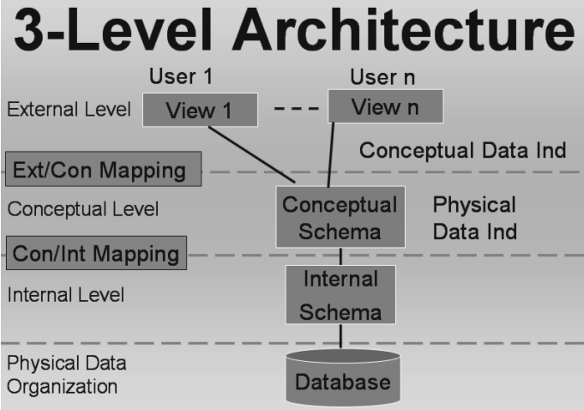
Database Management System (CS403)
VU
This could be serious because any application which is using this
attribute may not be independence available change, i t means that
able to run any more. So having data to us we still get problem after a certain before making a certain change its impact
should also be kept in mind and the changes should be made while remaining in the limits of the data independence.
Fig:3 . The levels where independence are effective
the Conceptual and
Physical
data
Physical Data Independence
Physical data independence is that type of independence that provides us changes transparency between the conceptual and internal levels. I-e the changes made to internal level shall not affect the conceptual level. Although the independence exist but as we saw in the previous case the changes made should belong to a specific domain and should not exceed the liberty offered by the physical data independence. For example the changes made to the file organization by implementing indexed or sequential or random access at a later stage, changing the storage media, or simply implement a different technique for managing fi le indexes or hashes.
Functions of DBMS
o Data Processing
37
© Copyright Virtual University of Pakistan

Slide 38
Database Management System (CS403)
VU
A user accessible Catalog
Transaction Support
Concurrency Control Services
Recovery Services
Authorization Services
Support for Data Communication
Integrity Services
DBMS lies at the heart of the course; i t is the most important component of a database system. To understand the functionality of DBMS it is necessary that we understand the relation of database and the DBMS and the dissection of the set of functions the DBMS performs on the data stored in the database.
Two important functions that the DBMS performs are:
User management Data Management
The detailed description of the above two major activities of DBMS is given below;
Data Processing
By Data management we mean a number of things i t may include certain operations on the data such as: creation of data, Storing of the data in the database, arrangement of the data in the databases and data-stores, providing access to the data in the database, and placing of the data in the appropriate storage devices. These action performed on the data can be classified as data processing.
A User Accessible Catalog
DBMS has another very important task known as access proviso to catalog. Catalog is an object or a place in the DBMS which stores
almost all of the information of the database, including schema information, user information right of the users, and many more
things about the database. Modern relational DBMS require that the Administrative users of the database should have access to the catalog of the database.
o Transaction Support
DBMS is responsible for providing transaction support. Transaction is an action that is used to perform some manipulation on the data stored in the database. DBMS is responsible for supporting all the required operations on the database, and also manages the
38
© Copyright Virtual University of Pakistan

Slide 39
Database Management System (CS403)
VU
transaction execution so that only the authorized and allowed actions are performed.
Concurrency Support
Concurrency support means to support a number of transactions to be executed simultaneously, Concurrency of transactions is managed
in such a way that if two or more transactions is making certain processing on the same set of data, in that case the result of all the transactions should be correct and no information should be lost.
Recovery Services
Recovery services mean that in case a database gets an inconsistent state to get corrupted due to any invalid action of someone, the DBMS should be able to recover i tself to a consistent state, ensuring that the data loss during the recovery process of the database remains minimum.
Authorization Services
The database is intended to be used by a number of users, who will perform a number of actions on the database and data stored in the database, The DBMS is used to allow or restrict different database users to interact with the database. It is the responsibility of the database to check whether a user intending to get access to database is authorized to do so or not. If the user is an authorized one than what actions can he/she perform on the data?
Support for Data Communication
The DBMS should also have the support for communication of the data indifferent ways. For example if the system is working for such an organization which is spread across the country and i t is deployed over a number of offices throughout the country, then the DBMS should be able to communicate to the central database station. Or if the data regarding a product is to be sent to the customers worldwide i t should have the facility of sending the data of the product in the form of a report or offer to its valued customers.
Integrity Services
Integrity means to maintain something in i ts truth or originality. The same concept applies to the integrity in the DBMS environment. Means the DBMS should allow the operation on the database which are real for the specific organization and i t should not allow the false information or incorrect facts.
39
© Copyright Virtual University of Pakistan

Slide 40
Database Management System (CS403)
VU
DBMS Environments:
Single User
Multi-user
Teleprocessing
File Servers
Client-Server
o Single User Database Environment This is the database environment which accessing the database at a specific time.
supports only one user The DBMS might have a
number of users but at a certain time only one user can log into the
database system and use i t. This type of DBMS systems called Desktop Database systems.
are also
Multi-User Database systems
This is the type of DBMS which can support a number
simultaneously interacting with the database in different number of environments exist for such DBMS.
Teleprocessing
of users ways. A
This type of Multi user database systems processes the user requests at a central computer, all requests are carried to the central computer where the database is residing, transactions are carried out and the results transported back to the terminals (literally dumb terminals). It has become obsolete now.
File Servers
This type of multi-user database environment assumes another
approach for sharing of data for different users. A fi le server is used to maintain a connection between the users of the database system. Each client of the network runs its own copy of the DBMS and the database resides on the f ile server. Now whenever a user needs data from the file server i t makes a request the whole file containing the required data was sent to the client. At this stage i t is important to see that the user has requested one or two records from the database but the server sends a complete file, which might contain hundreds of records. Now i f the client after making the desired operation on the desired data wants to write back the data on the database he will have to send the whole file back to the server, thus causing a lot of network overhead. The Good thing about this approach is that the server does not have lots of actions to do rather it remains idle for lots of the time in contrast with that of the teleprocessing systems approach.
Client-Server
40
© Copyright Virtual University of Pakistan

Slide 41
Database Management System (CS403)
VU
This type of multi- user environment is the best implementation of the network and DBMS environments. It has a DBMS server machine which runs the DBMS and to this machine are connected the clients having application programs running for each user. Once a users
wants to sends i ts software; performs
perform a certain operation on data in the database i t requests to the DBMS through its machine’s application the request is forwarded to the DBMS server which
the required operation on data in
the database stored in the result to the user best suited for large
the dame computer and then passes back intending the result. This environment is
enterprises where bulk of data is processed and requests are very much frequent.
This concludes the topics discusses in the lecture No4 . In the next lecture Database application development process will be discussed
Exercises:
Extend the format of data from the exercise of previous lecture to include the physical and internal levels. Complete your exercise by including data at all three levels
Think of different nature of changes at all three levels of database architecture and see, which ones will have no effect on the existing applications, which will be adjusted in the inter-schema mapping and which will effect the existing applications.
41
© Copyright Virtual University of Pakistan

Slide 42
Database Management System (CS403)
VU
Lecture No. 05
Reading Material
“Database Systems Principles, Design and Implementation” written by Catherine Ricardo, Maxwell Macmillan.
2.3.2, 2.4
Overview of Lecture
Database Application Development Process
Preliminary Study of System
Tools used for Database system Designing
Data Flow Diagrams
Different types of Data flow Diagram
Database design and Database Application design are two almost similar concepts, form the course point of view it is worthwhile to mention that the course is mainly concerned with designing databases and it concentrates on the activities which are performed during the design of database and the inner working of the database. The process that will be discussed in this lecture for development of database is although not a very common one, but it specifies all the major steps of database development process very clearly. There exist many ways of system and database development which are not included in the scope of this course. But we will see only those portions of the other processes which are directly related with the design and development of database.
Database Application development Process includes the Following Stages or steps:
Database Design
Application Programs
Implementation
42
© Copyright Virtual University of Pakistan

Slide 43
Database Management System (CS403)
VU
These three steps cannot always be considered as three independent steps performed in a sequence or one after another. Rather, they occur in parallel, which means that from a certain point onward the application programs development may run in parallel with the database design stages, specially the last stages of the database design. Similarly while the design phases of the database are in progress, certain phases of the application programs can also be initiated, for example, the initial study of the screens’ format or the reports layout. The database design process that we are going to discuss in this course does not take these steps independently and separately, and since the major concern of this course is the design stages of the database, it concentrate only on those.
o Database Design:
This part of the database application development process is most important process with
respect to the database application development, because the database is something that
will hold the organizations’ data, in case the design of the database is not correct or is not correctly reflecting the situations or scenarios of the organization then it will not produce correct result, or even just produce errors in response to certain queries. So this portion of the database design is given great attention when designing a database application.
Database Development Process
The database development process means the same thing that we have mentioned as
database application development process. Rather than discussing three stages of database application development separately, the steps given in the database development process include steps that cover all three phases mentioned for the database application development process.
Preliminary Study:
Design of database is carried out in a number of steps; these steps play important role in
the design process and need to be given proper attention First Phase of the database development process is the Preliminary Stage, which is based on the proper study of the system. It means that all the parts of the systems, or the section of the subject
43
© Copyright Virtual University of Pakistan

Slide 44
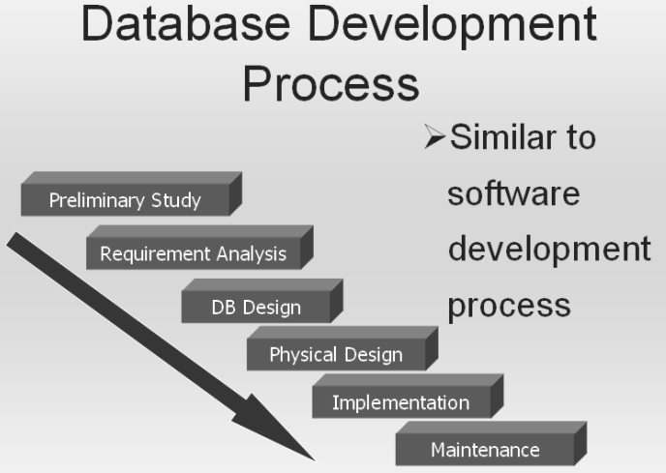
Database Management System (CS403)
VU
organization for which we intend to develop the system must be studied. We should find the relation or interaction of different section of the organization with each other and should understand the way information flows between different sections of the organization. Moreover it should also be made clear that what processing is performed at each stage of the system.
o Requirement Analysis:
Once we have investigated the organization for its different sections and the way data
flows between those sections. Detailed study of the system is started to find out the
requirements of each section. This phase is the detailed study of the system and its functionality decisions made at this stage decide the overall activity of the organization. Requirements of one section of the organization are fulfilled in such a way that all the sections in the organization are supporting each other, for example we can say that the results produced by the processing taking place at one section are used as input for another section. All the users of the systems are interviewed and observed to pinpoint and precisely define the activities taking place in the different section of the organization.
Fig: 1. Database Development process
o Database Design:
44
© Copyright Virtual University of Pakistan

Slide 45
Database Management System (CS403)
VU
Third stage in the database development process is the database design; this is a rather technical phase of the process and need handsome skill as a Database Administrator. This is the phase where the logical design of the database is created and different schemas for the database are created logically. Entities are identified and given attributes, relationships are built and different types of entity mappings are performed.
o Physical Design
This is the phase where we transform our logical design into a Physical design by
implementing the designed database onto a specific DBMS; the choice of the DBMS is
made on the basis of requirements and the environment in which the system will operate. Implementing a database on a specific DBMS is very important because it involves the major financial investment of the organization, and can not be reverted in case a selected DBMS in not capable of providing the desired efficiency.
o Implementation:
This phase is specific to writing the application programs needed to carry out different
activities according to use requirements. Different users may have different requirements
of the data in the database, so the number of application programs is not known or fixed for all the organizations, it may vary for different organizations.
o Maintenance of the Database System:
Maintenance means to fine tune the system and check that the designed applications
systems are fulfilling the purpose for which they are meant. Also this phase may involve designing any new application for the enhancement of the system. Or an already working application may need to be updated or modified to remove any errors or to add some functionality in the system. The phases involved in the development of the database application are expressed graphically in Figure-1.
All these stages are necessary and must be given the necessary attention at each level to get properly working and good system design and a better working environment.
45
© Copyright Virtual University of Pakistan

Slide 46
Database Management System (CS403)
VU
Database Development Process: Approach 2
There are other development processes also with some of the stages or steps modified as
compared to the model we have just studied. Such and alternative is given in the Figure-2 below. In this design process we see some of the design stages which existed in the previous designing steps but some of the stages are modified or merged with others to get more precise result or to distinguish different separate design phases. In this process of designing; the following steps exist:
Analyze User Environment
Develop Conceptual Model
Map Conceptual Model to Logical
Choose DBMS
Develop Physical Design
Implement System
Test System
Operational Maintenance
Analyze User Environment
This is same step as we discussed while discussing the previous designing process
Develop Conceptual Model
Next stage in this process model is the development of conceptual model or schema Here
we actually transform the studied and analyzed information into the conceptual design of
the database, this stage may also be connected with the requirement analysis phase, as expressed in the diagram by showing an arrow from this stage back to the first stage.
Map Conceptual Model to Logical Model
Third stage is the mapping of the developed conceptual model to the logical model of the
database, means at this stage the schema rules are defined and identified for general database structures.
Choose DBMS
Once the mapping of the conceptual and logical model is done, the decision for the use of
DBMS is made; again we refer to the previous model for selecting of the DBMS and will take care of all the necessary requirements of the environment before making a decision.
46
© Copyright Virtual University of Pakistan

Slide 47
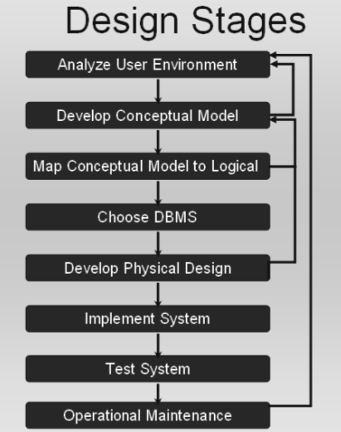
Database Management System (CS403)
VU
o Develop Physical Design
Once we have selected a DBMS, the logical design is then transformed into physical
design. This also includes considering many other decisions, like, data type allocation, indexes to be created, file organizations, etc. Physical database design is achieved by using the DBMS specific rules for schema definition and all the facilities provided by the DBMS,
Fig: 3. Database Development Stages. (Second Approach)
Implement System
This stage is also similar to the one described earlier, i.e., designing the application for
different users and user groups of the organization.
Test System
Testing is important in the sense that an application may be producing incorrect results,
and this incorrectness may lead to the inconsistency of the system. So when a system
47
© Copyright Virtual University of Pakistan

Slide 48
Database Management System (CS403)
VU
design is complete, once it is implemented it must be tested for proper operation and all the modules must be checked for their correctness. Whether the system modules are
important or not because the result of the system is mostly dependent on the proper the functionality of all database applications and modules.
o Operational Maintenance:
Maintenance means to check that all parts of the system are working and once the testing
of the system is completed the periodic maintenance measure are performed on the system to keep the system in working order.
Tools Used for Database System Development:
Why tools are used?
Tools are used for describing the design process in standard ways. If there is no
standardized tool available for designing a specific systems; Then everyone will have to use its own design notation, and a notation used by one designer may not be understandable to the another one. This misunderstanding can be more drastic if both the designers are working for the development of the same system. Tools can also help the designer and the user to mutually agree on a specific design.
Data Flow Diagrams:
The most common tool used for deigning database systems is Data Flow Diagram. It is
used to design systems graphically and expresses different system detail in different DFD levels.
DFDs show the flow of data between different processes o a specific system. DFDs are simple, and hide complexities.
DFDs are Descriptive and links between processes describe the information flow.
o Limitation of DFDs
They do not provide us a way of expressing decision points.
48
© Copyright Virtual University of Pakistan

Slide 49
Database Management System (CS403)
VU
DFDs are focused on flow of information only.
Symbols used in DFD:
There are a limited number of symbols which are used for design process in DFDs.
DATAFLOW:
The purpose of the dataflow in a DFD is to express the flow of information from one
entity to another entity in the system
Data flows are pipelines through which packets of information flow.
Arrows are labeled with name of the data that moves through them. Figure-4 below show the Dataflow diagram
Fig: 4. Dataflow Symbol
o DATA STORE:
Data store is a repository for the storage of the data. When in a system the data is to be
permanently stored somewhere for future reference or use the DATASTORE is used for
this purpose. It is express with a rectangle open on right width and left width of the rectangle drawn with double lines.
Data in the DATASTORE is held sometimes for processing purposes also i-e it may not be a permanent data store.. Name of the DATASTORE is a noun which tells the storing location in the system. Or identifies the entity for which data is stored. Figure-5 shows a data store.
Fig: 5. Data store
o Processes:
Processes are expressed with ovals or rounded rectangles. Processes are used to express
the transformation of incoming dataflow into outgoing dataflow. Process symbols are
used for whatever is the action taking place and whatever is the magnitude or complexity of the action. Simply stating when data is transformed from one form into another the process symbol is used. Figure-6a and Figure-6b show two different shapes used for presenting process in DFD.
49
© Copyright Virtual University of Pakistan

Slide 50
Database Management System (CS403)
VU
Fig: 6a
Process
Fig-6b
o DFD-Process:
In DFD processes are numbered for expressing their existence at a certain level in the
system.
1.0
1.0
Process
Process
Fig: 7. Numbered DFD Processes
o External Entities:
These are the entities interacting with the system in any of two different ways. They may
be either receiving the data from the system, or may be producing the data for the system to consume.
Shape used to express external entities is rectangle. The shape for external entity is
shown in Figure-8.
Fig: 8. External Entity
o Collector:
This DFD shape is used to express several dataflow connections terminating at a single
location. Collector is used to show the convergence of data to a single point. Fig 9a
shows the Collector symbol and Fig 9b show a collector symbol acting as a sink for multiple data flows.
50
© Copyright Virtual University of Pakistan

Slide 51
Database Management System (CS403)
VU
Fig: 9a Collector Fig 9b. Collector with Multiple Dataflow
o Separator:
The dataflow symbol which is used for separating data from a single source to multiple
sinks is known as a separator.
Figure 10a show the presentation of separator and the figure 10b shows the separator as it may appear in a DFD.
Fig: 10a Separator Fig 10b. Separator with Multiple Dataflow
o Ring Sum Operator:
This operator is used when data from a source process can flow to one of the mentioned
sinks. For this purpose the symbol used is displayed in Figure: 11a and its presentation in a DFD is expressed in Figure-11b.
Fig: 11a Ring sum operator Fig 11b. Separator with Ring sum operator
o AND Operator:
This operator is used when data from a source process must flow to all the connected
sinks. For this purpose the symbol used is displayed in Figure: 12a and its presentation in a DFD is expressed in Figure-12b.
51
© Copyright Virtual University of Pakistan

Slide 52
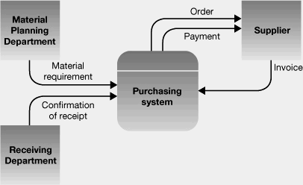
Database Management System (CS403)
VU
Fig: 12a AND operator Fig 12b. Separator with AND operator
Types of DFD
Context diagram
Level 0 diagram
Detailed diagram
o Context Diagram:
This is the level of DFD which provides the least amount of details about the working of
the system. Context DFDs have the following properties:
They always consist of single process and describe the single system. The only process
displayed in the CDFDs is the process/system being analyzed. Name of the CDFDs is generally a Noun Phrase.
Fig: 13a. Example Context DFD Diagram
No System details are shown in the Contexts DFDs just context is shown. Input and output from and to the process are shown and interactions are shown only with the external entities. An example DFD at context level is shown in Figure: 13a and 13b.
52
© Copyright Virtual University of Pakistan

Slide 53
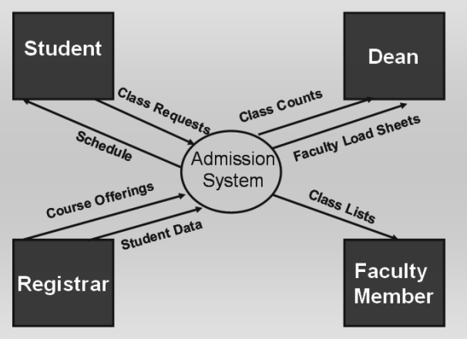
Database Management System (CS403)
VU
In the context level DFDs no data stores are created. Ant dataflow from external entities are only directed toward the purported system and vice versa, no communication is show between external entities themselves.
Fig: 13b. Example Context DFD Diagram
Level 0 Data Flow Diagrams:
The level 0 Diagram in the DFD is used to describe the working of the whole system.
Once a context DFD has been created the level zero diagram or level ‘not’ diagram is created. The level zero diagram contains all the apparent details of the system. It shows the interaction between a numbers of processes and may include a large number of external entities. At this level it is the duty of the designer to keep a balance in describing the system using the level 0 diagram. Balance means that he should give proper depth to the level 0 diagram processes. Because placing too much details and showing all of the miniature processes in the level 0 diagrams makes it too much complex. On the other hand it is also not recommended to just ignore even larger processes of the system, because in such a case although the level 0 DFD will become simple but now we will have to create large number of detail DFDs. So a balance in describing the system should be kept so that the depth of the Level 0 DFD is manageable.
Steps in creating the level 0 DFD
Identify distinct modules of the system for which to create the DFD
53
© Copyright Virtual University of Pakistan

Slide 54
Database Management System (CS403)
VU
Create DFDs for all the modules one by one to show the internal functionality of the system.
Once DFD for the distinct modules of the system have been created, establish link between different DFDs where required by either connecting the entities of the system, processes of the system or the data stores in different DFDs.
Now comes to the stage of placing the numbers on processes. As we know that the level 0 diagram encompasses a large number of smaller
systems, ant is a combination of a number of context DFDs. In level 0 diagram a process when it has a lot of details, it is not explained further in the level 0, and rather it is postponed for the detailed diagram.
In the detailed Data Flow and is given a number. Numbering processes is based on a specific notation, in the level 0 diagrams only left half or the portion before
the decimal point is valid but in the detailed diagram when a complex process is expressed further its sub processes are number like 1.0, 1.1, and 1.2 and so on.
54
© Copyright Virtual University of Pakistan

